Slide 1
The setup
Camera
x
Casted ray
Screen
Sphere
Origin

Slide 2
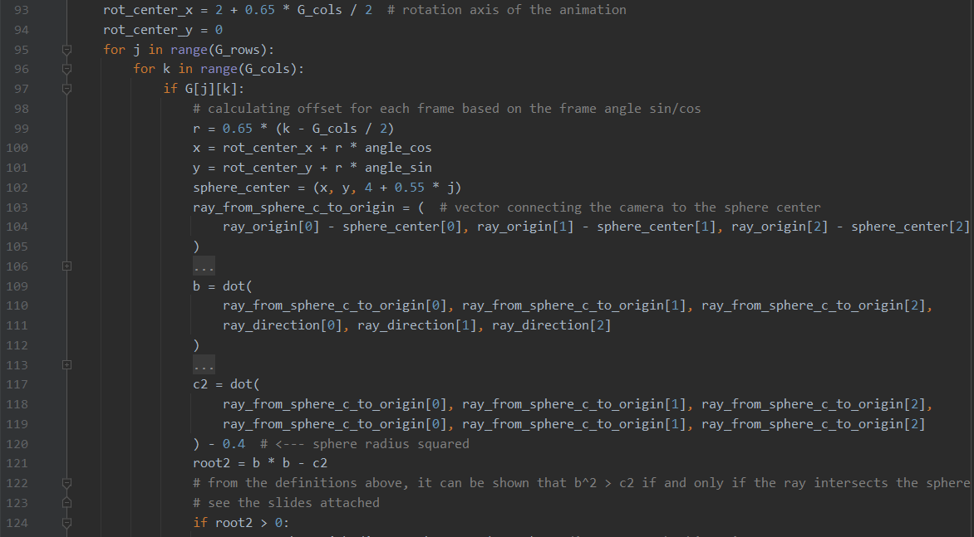
The code

Slide 3
The code simplified
ray_origin – sphere_center
ray_from_sphere_c_to_origin ◦ ray_direction
ray_from_sphere_c_to_origin² – sphere radius²

Slide 4
This code checks if the ray casted from the camera hits the sphere
Why does it work?

Slide 5
Some helpful vectors
Camera
x
Casted ray
Screen
Sphere

Slide 6
What are they?
Unit vector of the casted ray direction
Ray origin vector (= camera position)
Sphere center vector

Slide 7
Line 103 – calculating the vector
from the sphere center to the camera
ray_from_sphere_c_to_origin
Ray origin vector (= camera position)
Sphere center vector

Slide 8
Line 109 – calculating distance between the camera and the point where casted ray is the closest to the sphere center
In line 109 we calculate dot product:
ray_from_sphere_c_to_origin ◦ ray_direction
where ray_direction is a unit vector along the casted ray.
By definition of the dot product with a unit vector, we calculate the projection of the ray_from_sphere_c_to_origin on the casted ray.
Thus, a line from the sphere center perpendicular to the casted ray will hit the ray b units away from the camera.

Slide 9
Line 109 – calculating distance between the camera and the point where casted ray is the closest to the sphere center
b
ray_from_sphere_c_to_origin

Slide 10
Let’s flatten the image – slice the 3D through the casted ray and the ray_from_sphere_c_to_origin
b_{out}
b_{in}
ray_from_sphere_c_to_origin
Three cases are possible:
- the casted ray hits the sphere, and is thus inside the circle (b_{in})
- the casted ray goes outside the sphere, and is thus outside the circle (b_{out})
- the casted ray is tangential to the sphere (omitted)
* Note that since ray_from_sphere_c_to_origin passes through the sphere center, the sphere of radius R is guaranteed to become a circle of radius R in 2D.

Slide 11
What distance b tells us? Let’s understand c² first:

Slide 12
Line 117 – what is c²?
c² = ray_from_sphere_c_to_origin² – sphere radius²
tangent
sphere radius
ray_from_sphere_c_to_origin
By the right triangle formula, c² is the square of the distance from the camera to the sphere along the tangent line

Slide 13
How c relates to b?
b_{out}
angle
tangent
b_{in}
ray_from_sphere_c_to_origin
For any ray b_{in} that goes through the sphere => through the circle, and any ray b_{out} that doesn’t go through the sphere => outside the circle,
The angle between the tangent and the ray_from_sphere_c_to_origin, i.e. angle(tangent), is:
larger than the angle between b_{in} and the ray_from_sphere_c_to_origin
smaller than the angle between b_{out} and the ray_from_sphere_c_to_origin
90º >= angle(b_{out}) > angle(tangent) > angle(b_{in}) >= 0º

Slide 14
b_{out}
angle
tangent
b_{in}
ray_from_sphere_c_to_origin
90º >= angle(b_{out}) > angle(tangent) > angle(b_{in}) >= 0º
Notice that all the three triangles on the image are the right triangles.
Thus b_{any} = cos(angle(b_{any})) x ray_from_sphere_c_to_origin, and the latter is fixed term.
For angles 0-90º cosine is a strictly decreasing function, thus:
cos(angle(b_{out})) < cos(angle(tangent)) < cos(angle(b_{in}))
Thus, b_{out} < tangent < b_{in} , or, since all values are positive:
b²_{out} < tangent² < b²_{in}

Slide 15
And what do we check in lines 121-124?
b x b – c² > 0 , or, equivalently, b² > c² = tangent² Which, as we have just proven, true if and only if the casted ray is going through the sphere, QED.

